Slide 1
Credit for this presentation
Shakuntala Thilsted, a member of the Steering Committee of the High Level Panel of Experts on Food Security and Nutrition (HLPE) gave a presentation on the HLPE Issues Paper on the Impacts of COVID-19 on food security and nutrition: developing effective policy responses to address the hunger and malnutrition pandemic.
The drafting team of the Issues Paper consisted of Team Leader: Jennifer Clapp (Steering Committee); and Team members: William Moseley (Steering Committee), and Paola Termine (Secretariat).
Recommended citation: HLPE. 2020. Impacts of COVID-19 on food security and nutrition: developing effective policy responses to address the hunger and malnutrition pandemic. Rome.https://doi.org/10.4060/cb1000en
This presentation was used during the breakfast seminar ”Covid-19’s effect on global food systems and how to respond” on the 3rd December 2020 hosted by SLU Future Food, www.slu.se/ew-kalender/2020/12/covid-19s-effect-on-global-food-systems-and-how-to-respond

Slide 2
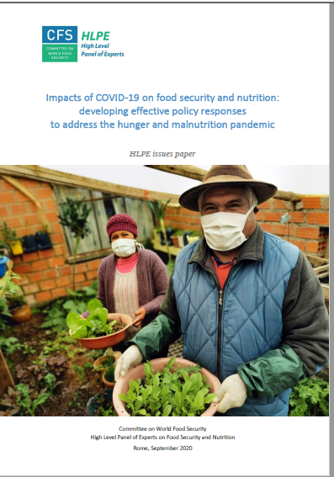
Impacts of COVID-19 on Food Security and Nutrition:
Addressing the Hunger and Malnutrition Pandemic
(HLPE issues paper, September 2020)
Presented by: Shakuntala Thilsted
Member, Steering Committee of the HLPE on Food Security and Nutrition
Research Program Leader, WorldFish

Slide 3
Outline
Introduction
How COVID-19 is affecting food security and nutrition
  Primary trends affecting food security and nutrition
  Implications for the six dimensions of food security
Recommendations
Conclusion

Slide 4
Introduction
COVID-19 pandemic: Situation is fluid and dynamic
SOFI 2020 estimates: 83 – 132 million people will be added to the ranks of the world’s hungry due to COVID-19 – revised in June 2020 to 100 – 120 million people
World Bank estimate: (October 2020): 88 – 115 million people will be pushed into extreme poverty this year, with the total rising to 150 million by 2021
IFPRI estimate: Increase of 100 million people experiencing chronic hunger and extreme poverty in 2020
Healthy diets were not affordable for 3 billion people before the pandemic, and is expected to increase substantially with the pandemic
Urgent need to build more resilient food systems in face of this crisis

Slide 5
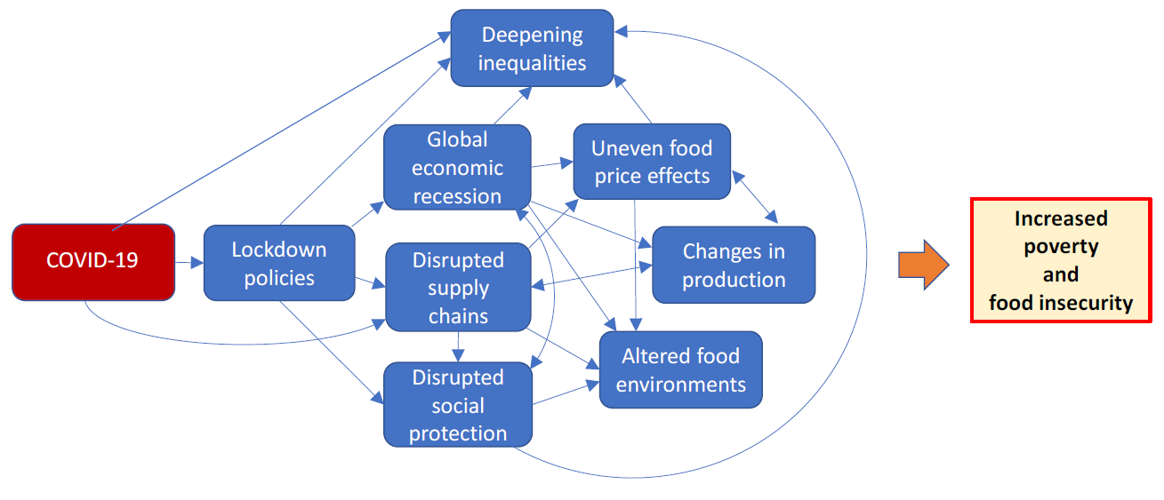
How COVID-19 is affecting food security and nutrition
These trends overlap in complex ways; not always easy to disentangle
Increased poverty and food and nutrition insecurity

Slide 6
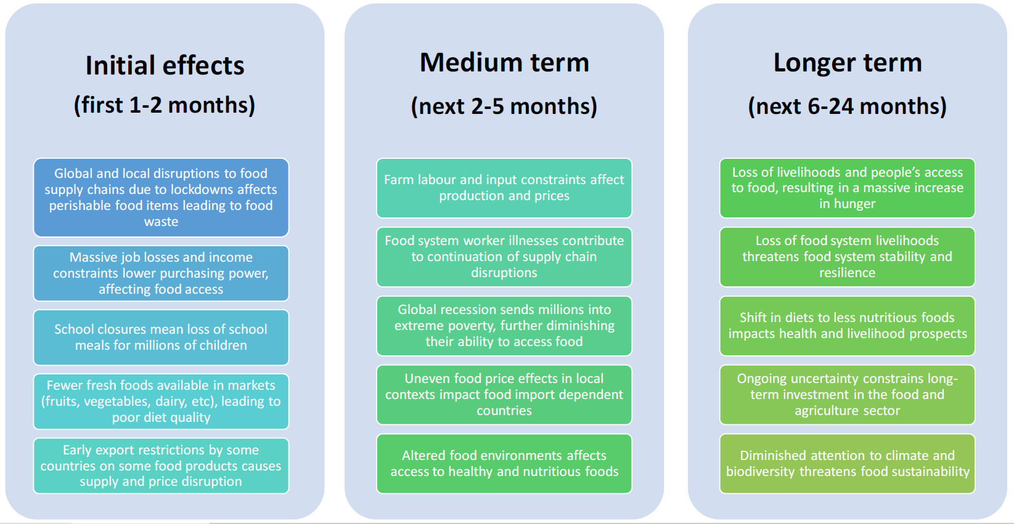
Impact of COVID-19 on FSN changes over time

Slide 7
COVID-19 impact on six dimensions of food security and nutrition

Slide 8
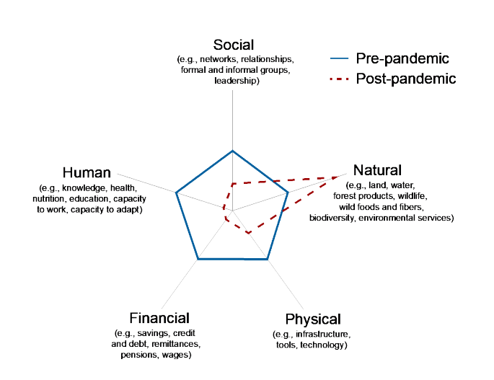
COVID-19 and shifts in household portfolio
COVID-19 pandemic is expected to shift the balance of household’s capital to increase reliance on natural capital
Human and financial capitals are directly reduced while social and physical capitals are inaccessible
Source: Fiorella et al. (2020)

Slide 9
Recommendations
The recommendations in HLPE Issues Paper on COVID-19 build on the four policy shifts advocated in the HLPE #15 Report: Food Security and Nutrition: Building a Global Narrative Towards 2030 (June 2020)
These four policy shifts call for longer-term achievement of FSN and meeting goals of the SDGs

Slide 10
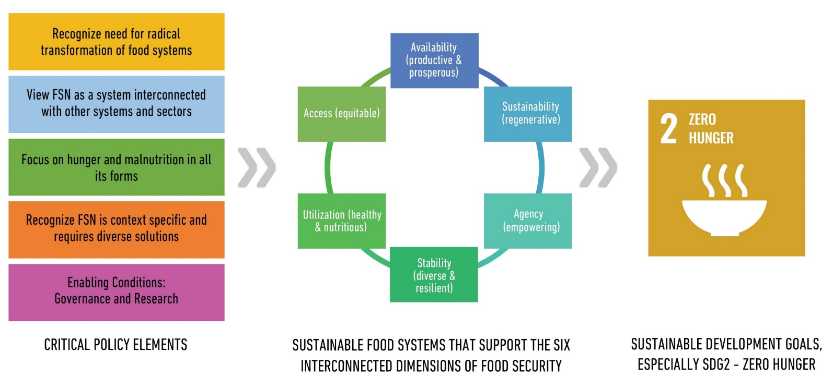
Theory of change

Slide 11
Summary of Recommendations
Implement more robust targeted social protection programmes to improve access to healthy and nutritious foods, including emergency food aid, maintaining robust safety nets, food assistance programmes focused on healthy food, and ensuring access to alternatives to school lunches when schools are closed. Debt relief should be provided to governments in need.
Ensure better protection for vulnerable and marginalized food system workers and farmers, including the recognition of their labour rights in national legislation, access to full protection from hazards and risks – paying special attention to migrant workers, mechanisms to protect farmers and small-agricultural producers from uncertainties and income losses.
Provide better protection for countries that depend on food imports, which are especially vulnerable to supply chain disruptions. Measures include discouraging export restrictions as a response to the pandemic and, in the longer term, support countries to increase their domestic food production capacity.

Slide 12
Summary of Recommendations
Strengthen and coordinate policy responses to the COVID-19 pandemic impact on food systems and food security and nutrition to address the interlinkages of food, health, economic and environmental systems. Recognizing the role of the CFS as a lead body in coordinating an international governance response to the impact of COVID-19 on FSN and in facilitating information sharing among governments to track these impacts are among the recommended actions.
Support more diverse and resilient distribution systems, including shorter supply chains and territorial markets, and support small- and medium-scale agri-food enterprises’ participation in supply chains.
Support more resilient food production systems based on agroecology and other sustainable forms of food production, including by strengthening local food production and ensure that not only farming, but also sustainable fisheries and aquaculture, animal production and forestry are central in policy responses to COVID-19.

Slide 13
Conclusion
COVID-19 is an unexpected shock that crippled and exposed the flaws in our food systems (in various pathways and affecting both demand and supply of food).
The pandemic derailed us further in achieving the goals of SDG 2: Zero Hunger by 2030.
COVID-19 is just one of many shocks – more to be expected.
What has COVID-19 taught us?
How has COVID-19 prepared us to cope/build resilience for the future?

Slide 14
WorldFish: COVID-19 Responses
WorldFish is developing research responses on aquatic food systems following the initial shock of COVID-19:
  Impacts of COVID-19 on aquatic food supply chains in Bangladesh, Egypt, India, Myanmar, Nigeria and Timor-Leste, February – April 2020 (Published: October 2020)
  Qualitative assessment of COVID-19 impacts on aquatic food value chains in Bangladesh (Published: October 2020)
A dashboard was created to provide information and high-frequency data for policy interventions across different stakeholder groups: government, policy makers, small-scale fishers, food producers, consumers, women and men:
  https://www.worldfishcenter.org/pages/covid-19/
To partner with us or to learn more about the transformational power of aquatic foods: www.worldfishcenter.org

Slide 15
Thank you!

